Slide 1
Leading in times of crises
Paul ’t Hart
Utrecht University
Netherlands School of Public Administration
Australia New Zealand School of Government

Slide 2
Emergencies and critical incidents: official definitions
Physical impact: lives/health, infra, property, economy
Response required: exceeds regular jurisdictional capacities
An ‘event’: demarcated, finite
➔ Need for high-speed, high-consequence, decision-making, mobilisation and action

Slide 3
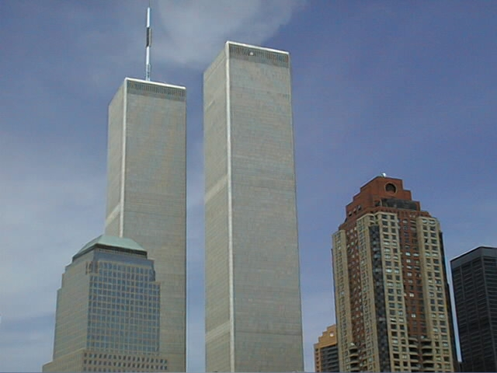
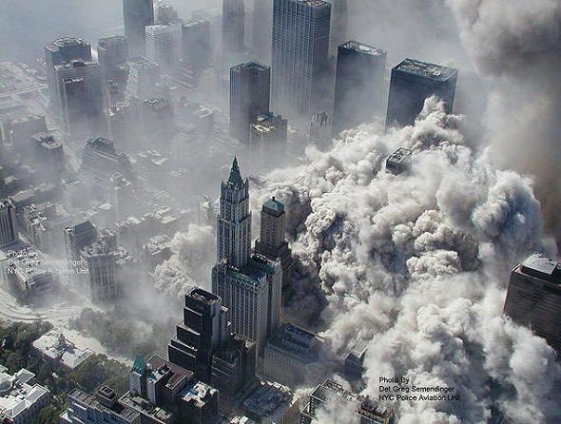
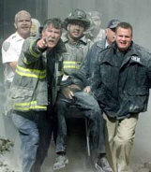
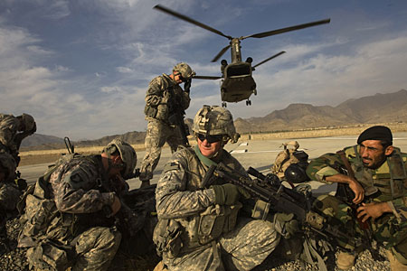
Problem 1: Crises are not ‘incidents’ but ‘processes’
Pre-disturbance stage:
Prevention
Preparedness
Incubation
Disturbance stage:
Trigger/escalation
Arousal
Mobilisation/response
Post-disturbance stage:
Investigation -> ‘learning’
Adaptation (‘recovery’)
Memory

Slide 4
Problem 2: Incidents are fundamentally ambiguous and conflictual…
Symbolic impact: collective stress, breakdown of meaning, control, security
Strategic impact: questioning policies, institutions, office-holders, power relations

Slide 5
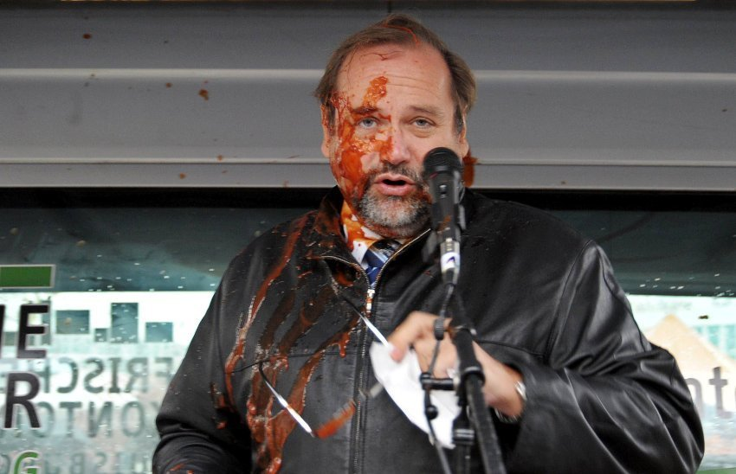
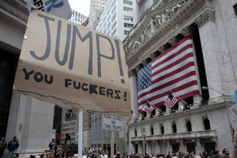
….therefore generating:
Relentless scrutiny
Rumour, speculation, allegation
Reputational damage
Responsibility pressures
Rhetoric of change

Slide 6
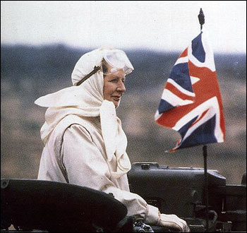
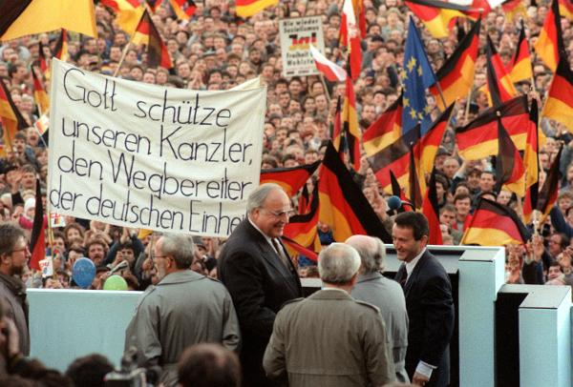
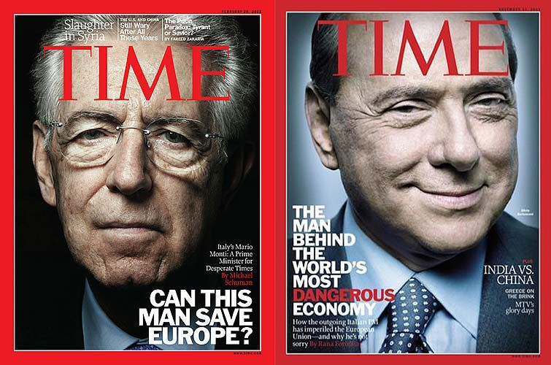
Crises are consequential: for leaders and governments
Test them
Break them
Make them

Slide 7
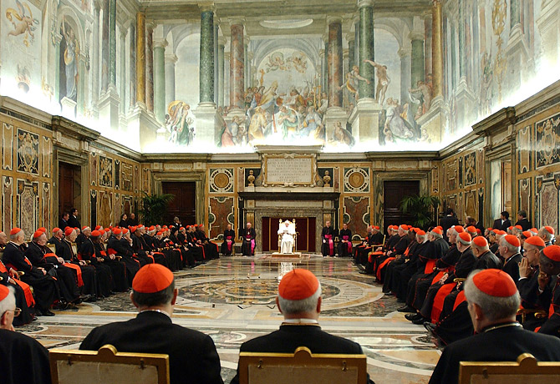
Crises are consequential: for organisations/institutions
Wound them
Kill them
Transform them
Create them
Expand them

Slide 8
Defining crises (as opposed to emergencies)
Situations of collective stress,
evoked by a combination of:
Perceived threat to core values and/or structures
High degree of uncertainty about causes, trajectories and intervention options
Perceived time pressure

Slide 9
The parallel universes of crisis management
The universe of restoration
Physical world:
signals, shocks, systems
Citizens as victims
Media report events
Key arenas:
‘on-site’, line agencies, coordination centers
Key stakes:
shock absorption, community resilience, reconstruction

Slide 10
The parallel universes of crisis response
The universe of restoration:
‘incident management’
Physical world:
signals, shocks, systems
Citizens as victims
Media report events
Actors & arenas:
‘on-site’, line agencies, coordination centers, commanders, experts
Stakes:
shock absorption, community resilience, reconstruction
The universe of brinkmanship:
‘crisis exploitation’
Psycho-political world:
passions, players, positions, programs
Citizens as advocates
Media frame interpretations
Actors & arenas:
inquiries, parties, parliaments, agency heads, advisers
Stakes:
political damage control, institutional futures, policy change/stability

Slide 11
=> Need to manage not just the incident (operational/tactical) but the crisis it generates (political/institutional This entails both risk and potential opportunity

Slide 12
Key challenges of crisis leadership (in both CM universes)
Sense-making: diagnosis
Organizing: coordination
Meaning-making: persuasion
Adapting: reflection and renewal

Slide 13
Leadership challenges
CM LOGIC LEADERSHIP CHALLENGE | INCIDENT MANAGEMENT | CRISIS EXPLOITATION
Sense-making | What is going on ‘on the ground’? What might happen next & later? | What is going on in the media, political and interagency arenas?
Organizing
Meaning-making
Adapting

Slide 14
Leadership challenges
CM LOGIC LEADERSHIP CHALLENGE | INCIDENT MANAGEMENT | CRISIS EXPLOITATION
Sense-making | What is going on ‘on the ground’? What might happen next & later? | What is going on in the media, political and interagency arenas?
Organizing | How can we mobilize the requisite operational capacity, and get its component parts working in tune? | How can we mobilize support for our position
Meaning-making
Adapting

Slide 15
Leadership challenges
CM LOGIC LEADERSHIP CHALLENGE | INCIDENT MANAGEMENT | CRISIS EXPLOITATION
Sense-making | What is going on ‘on the ground’? What might happen next & later? | What is going on in the media, political and interagency arenas?
Organizing | How can we mobilize the requisite operational capacity, and get its component parts working in tune? | How can we mobilize support for our position
Meaning-making | How do we inform and engage with the public to promote order and resilience? | How do we craft believable stories about our past, present and future actions in ongoing framing contest?
Adapting

Slide 16
Leadership challenges
CM LOGIC LEADERSHIP CHALLENGE | INCIDENT MANAGEMENT | CRISIS EXPLOITATION
Sense-making | What is going on ‘on the ground’? What might happen next & later? | What is going on in the media, political and interagency arenas?
Organizing | How can we mobilize the requisite operational capacity, and get its component parts working in tune? | How can we mobilize support a viable coalition behind us in the political & policy ‘battles’ the crisis will trigger?
Meaning-making | How do we inform and engage with the public to promote order and resilience? | How do we craft believable stories about our past, present and future actions in ongoing framing contest?
Adapting | How can we organize reflection and learning? | How do we survive (or capitalize on) blame game?

Slide 17
YOUR EXPERIENCES?
Four subgroups, one theme each, covering both CM universes
Key Q’s:
What have you found challenging in this (sense-making, organizing etc.) domain?
How have you/your organisation dealt with it?
Can/should you do better? What would that involve?

Slide 18
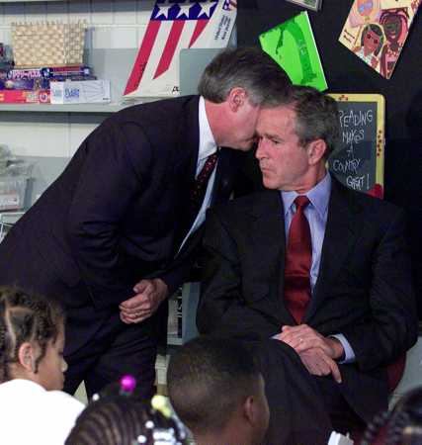
1. Sense-making
“What the hell is going on?”

Slide 19
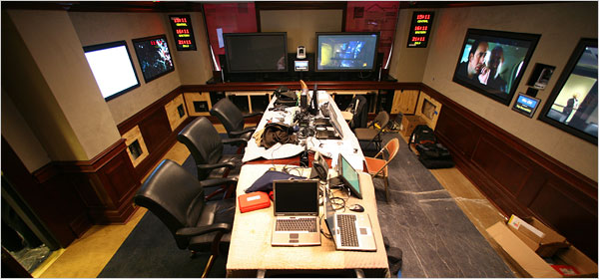
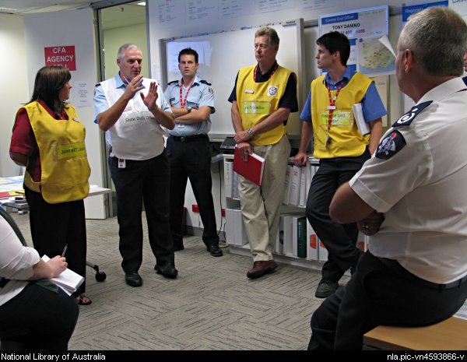
Sense-making dilemmas
SPEED vs ACCURACY
SIGNALS vs NOISE
EXPERIENCE vs NOVELTY
EMOTION vs ANALYSIS
NOW vs NEXT

Slide 20
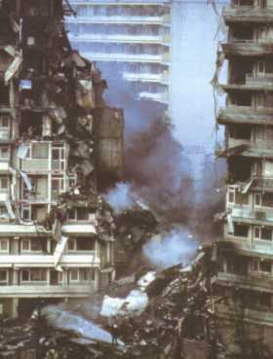
Sense-making: traps to avoid
Haste: Sacrificing rigor & smartness to speed & satisficing
Myopia: Ignoring the long term / political view
Bias: Dominance of veterans
Bunker syndrome: Isolation
Exhaustion: Body and psyche

Slide 21
Improving sense-making capacity
Harness wisdom of the crowd: maintain diverse, redundant, multi-level networks of expertise, including community-based expertise
Protect the long-term, dynamic view: Complement state-of-art C3I systems with dedicated capacity for strategic analysis amidst maelstrom of emergency response
Prevent tunnel vision: Institutionalise critical scrutiny of shared assumptions and images about unfolding crisis operations AND (potential) crisis politics

Slide 22
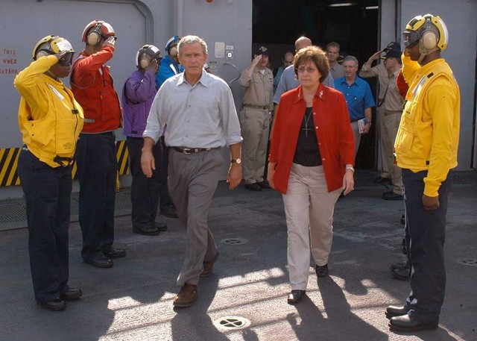
2. Organizing
“United we stand, divided we fall…”

Slide 23
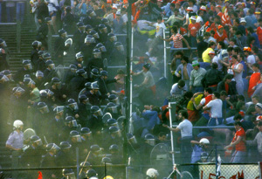
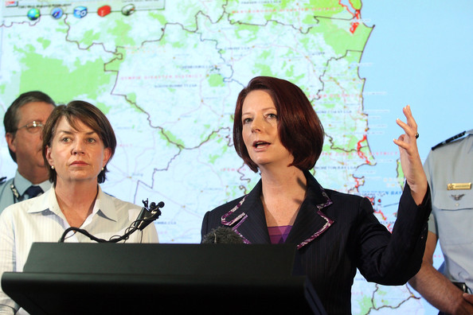
Organizing: dilemmas
PLAN vs IMPROVISATION
CENTRALIZED vs DECENTRALISED
TYPE 1 ORG’s vs THE RESt
DISASTER(S) vs ‘ALL HAZARDS’
STATE-CENTRIC vs HOLISTIC
RESPONSE vs ‘RECOVERY’

Slide 24
Organizing: traps to avoid
Central micro-management of local response tactics/operations
Coordination between ‘strangers’
Tolerating turf wars
Misconceiving and ‘misunderestimating’ recovery, accountability & learning challenges

Slide 25
Improving organizing capacity
Separate (but join up) response from recovery structures
Build cross-boundary collaborative networks of trust before crises hit
Leverage community self-organization and third sector involvement

Slide 26
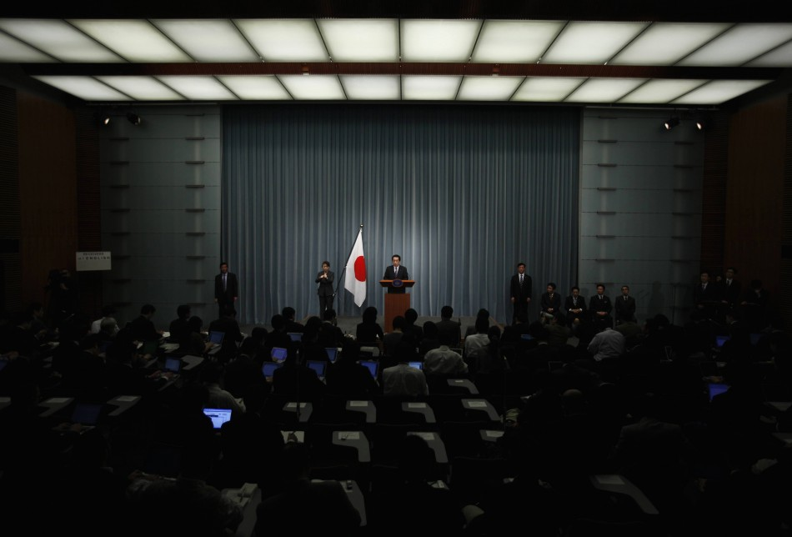
3. Meaning-making
Regulating public distress

Slide 27
Meaning making dilemmas
CERTAINTY vs TIMELINESS
EMPATHY vs AUTHORITY
DISCLOSURE vs TRANSPARENCY
DEFENDING vs ACKNOWLEDGING
PROMISE vs PRUDENCE

Slide 28
Meaning making in practice
Premier Anna Bligh (Qld floods):
http://www.youtube.com/watch?v=nfPXmEtyKrA

Slide 29
Meaning making in practice
Ronald Reagan, Challenger
http://www.youtube.com/watch?v=gEjXjfxoNXM

Slide 30
Meaning making as ‘performance’
Balance between logos, ethos, pathos
Balance between projecting strength/control vs empathy/fallibility
Balance between providing direction, protection and order vs mobilizing adaptive work

Slide 31
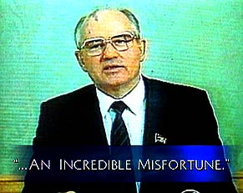
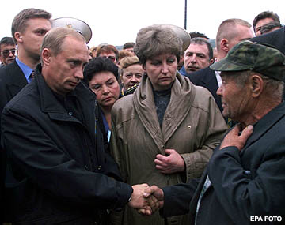
Meaning making: traps to avoid
Going public late: looking defensive
Uncontrolled formats: timing, setting, content
Technocracy: Logos only; forgetting pathos/politics
Paternalism: Thinking the public will panic
Aloofness: Not ’being there’
Overpromising: Making impossible commitments
Defensiveness: Appearance of hiding, denying, lying

Slide 32
Improving meaning-making capacity
Resources/skills for sustained real-time, multi-media, interactive communication
Rely on social science expertise (‘nudging’ etc.) instead of on crude assumptions about human behaviour
Prioritize (long-term) credibility in the face of crisis-induced framing contests

Slide 33
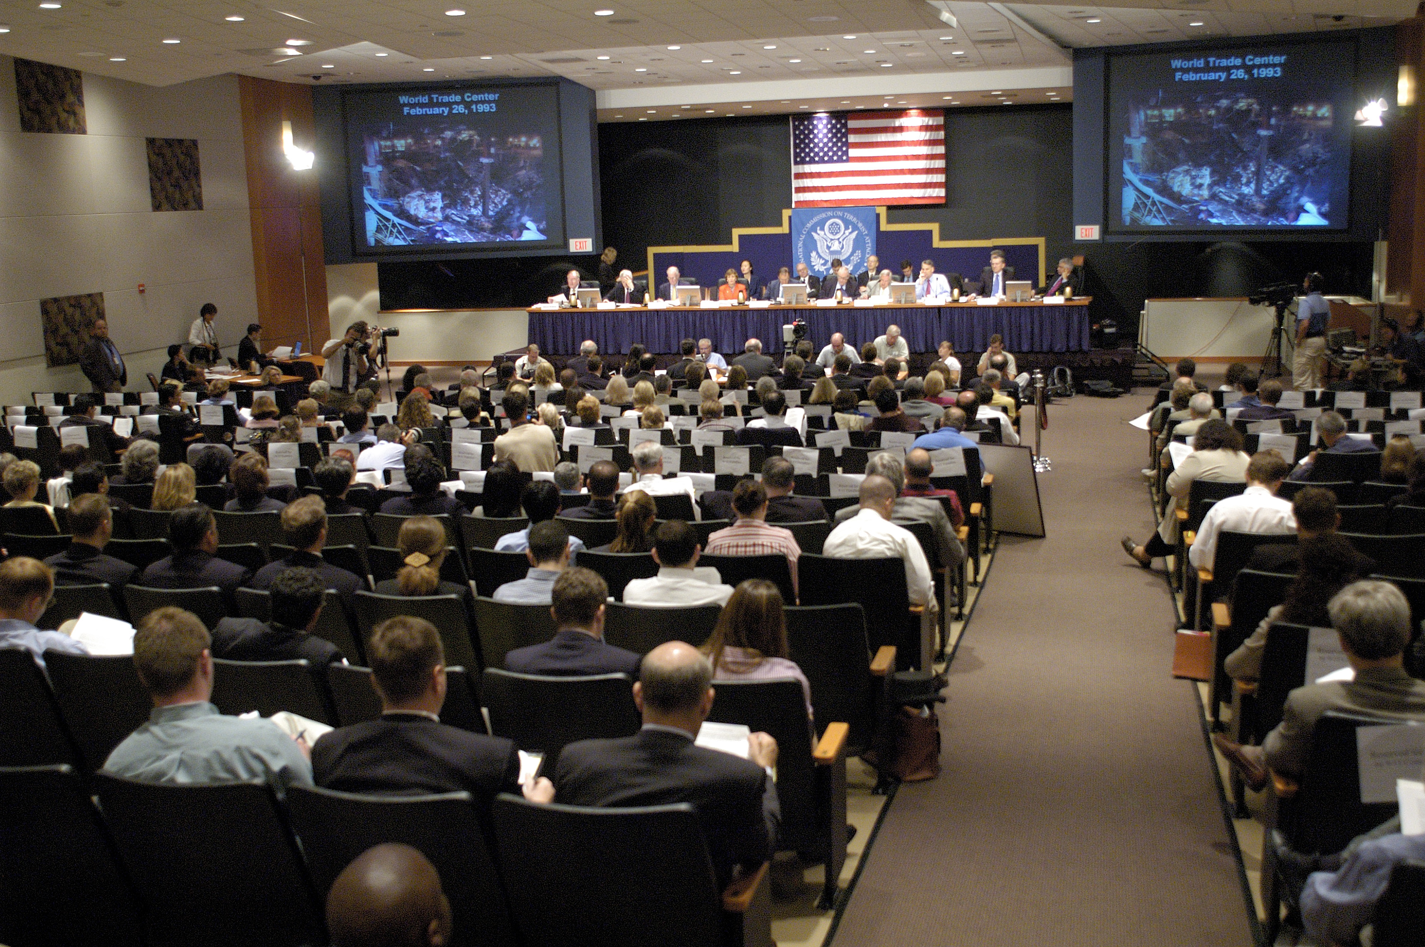
4.Adaptation
Nurturing reflection and renewal

Slide 34
Adaptation dilemmas
RECOVERY vs REFLECTION
RESTORATION vs RENEWAL
LEARNING vs BLAMING

Slide 35
Managing learning: traps to avoid
Covering up: conducting ’internal’ inquiries; sabotaging external inquiries
Going negative: unleashing blame games
Blame deflection: Creating/sustaining an `unsafe’ climate within the organization
Symbolic gestures: making fast, high-visibility changes regardless of diagnosis
Over-learning: obsession with the `last war’ at the expense of ‘all-hazards’ strategy
Shopping-list learning: comprehensive quest to implement all inquiry recommendations

Slide 36
Improving crisis-induced learning
Safeguard the integrity of post-crisis inquiry from pressures of post-crisis blame management
Differentiate between technical and adaptive learning challenges, and act accordingly
Broaden the evidence base: benchmark/contextualize the current case

